Slide 1
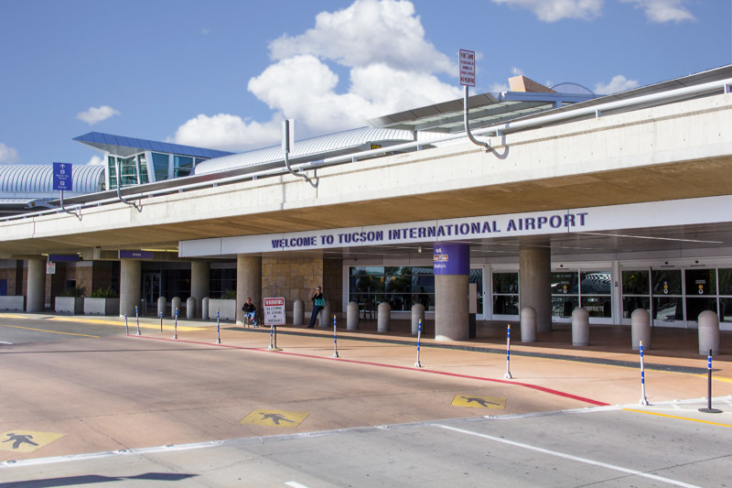
Opportunity for Public Comment - PFC Application 4
June 27, 2025

Slide 2
Overview
The Tucson Airport Authority (the Authority) intends to submit a new PFC application to the Federal Aviation Administration (FAA) for three projects at Tucson International Airport (the Airport)
The PFC Level for the Airport will continue to be $4.50 per eligible enplaned passenger
Estimated charge effective date for the application: November 1, 2025
Estimated charge expiration date for the application: April 1, 2028
Estimated total PFC revenue to be collected under application is $24,492,573; seeking an estimated $16,306,333 of PFC use authority
 | PFC Pay-as-you-go
Checked Baggage Inspection System (CBIS) (Design)^{/1} | $8,186,240
ASE Program - Land Acquisition/Bunkers Reimbursement | $849,300
ASE Program - Runway Construction | $15,457,033
TOTAL | $24,492,573
/1 The PFC request for Checked Baggage Inspection System (CBIS) (Design) will be on an impose only basis. The Authority will request PFCs on an impose and use basis for the remaining two projects in the application.

Slide 3
Opportunity for Public Comment
In accordance with Section 158.24 of 14 CFR Part 158, these materials constitute the notice of opportunity for public comment on the application and include:
PFC level, estimated total PFC revenue to be collected, proposed charge effective date, and estimated charge expiration date
Name and contact for the person within the public agency to whom the comments should be sent
A description and brief justification of the projects
Public comments may be submitted until July 28, 2025 and should be sent to:
Kim Allison, Vice President, Chief Financial Officer
kallison@flytucson.com

Slide 4
Proposed PFC Projects
Checked Baggage Inspection System (CBIS) (Design)
ASE Program - Land Acquisition/Bunkers Reimbursement
DESCRIPTION
This project includes design services associated with a new Consolidated Checked Baggage Inspection System (CBIS) and Baggage Handling System (BHS), including Explosive Detection Systems (EDS), at the Airport’s main airline terminal.
The new CBIS and BHS systems will be designed with the future terminal expansion in mind and the need to be integrated into the new terminal and not to hinder any future development plans. Once complete, the modernization and centralization of the CBIS and BHS systems will increase the overall safety, security, and efficiency of baggage movements at the Tucson International Airport.
JUSTIFICATION
In 2023, TUS served approximately 3.8M passengers. TUS is presently classified as a small-hub airport; however, traffic trends are leading TUS into medium-hub territory. The project is necessary to enhance capacity at the Airport.
DESCRIPTION
This project involves the acquisition of land in support of the Airport's Airfield Safety Enhancement (ASE) Program. The land being acquired is located in the footprint of the planned commercial parallel runway safety area.
JUSTIFICATION
The acquisition of land associated with this project is an enabling component of the Airfield Safety Enhancement (ASE) Program, which is necessary to enhance safety at the Airport.

Slide 5
Proposed PFC Projects
ASE Program - Runway Construction
DESCRIPTION
Tucson International Airport’s Airfield Safety Enhancement Program (ASE Program) is a multi-year phased project involving construction of new parallel commercial Runway 12R/30L. The completed runway will be constructed of concrete and will be approximately 11,000 feet by 150 feet with 25-foot asphalt shoulders on each side. This project includes the Runway Construction portion of the ASE Program, involving (1) construction of the cement treated base and the mobilization of the concrete batch plant, (2) the construction of concrete pavement section for the new runway, including conduit and fencing work, and (3) construction of shoulders and installation of lighting (including regulators), signage, and marking for the new runway.
JUSTIFICATION
The Airfield Safety Enhancement (ASE) Program is necessary to enhance safety at the Airport.

